Slide 1

Airbnb’s Booking Data Analysis

Slide 2
Business Understanding
Airbnb has provided their datasets related to Airbnb listings and reviewer scores worldwide to gain a deeper understanding of Airbnb's operations and draw meaningful insights from the data.

Slide 3
Data understanding
Let’s see what data do we have for Analysis.
Listing Details, Host Details, Location Details, Property Details, Listing Price, Review Score
Now, Let’s see what More data do we Need to have for better Analysis.
Blank Host Response Time
Blank Host Response Rate
Blank Host Acceptance Rate
Blank District Data
Blank Review Score Data
Data
Format - Xlsx
Number of Records – 2,79,713

Slide 4
Data preparation
How did i organize the data for modeling?
Checked Duplicate Data Entry. ( Found None )
Ignored Listing Name, Superhost, Profile Pic, Identity,
Deleted Longitude, Latitude, accommodates, bedrooms,
amenities

Slide 5
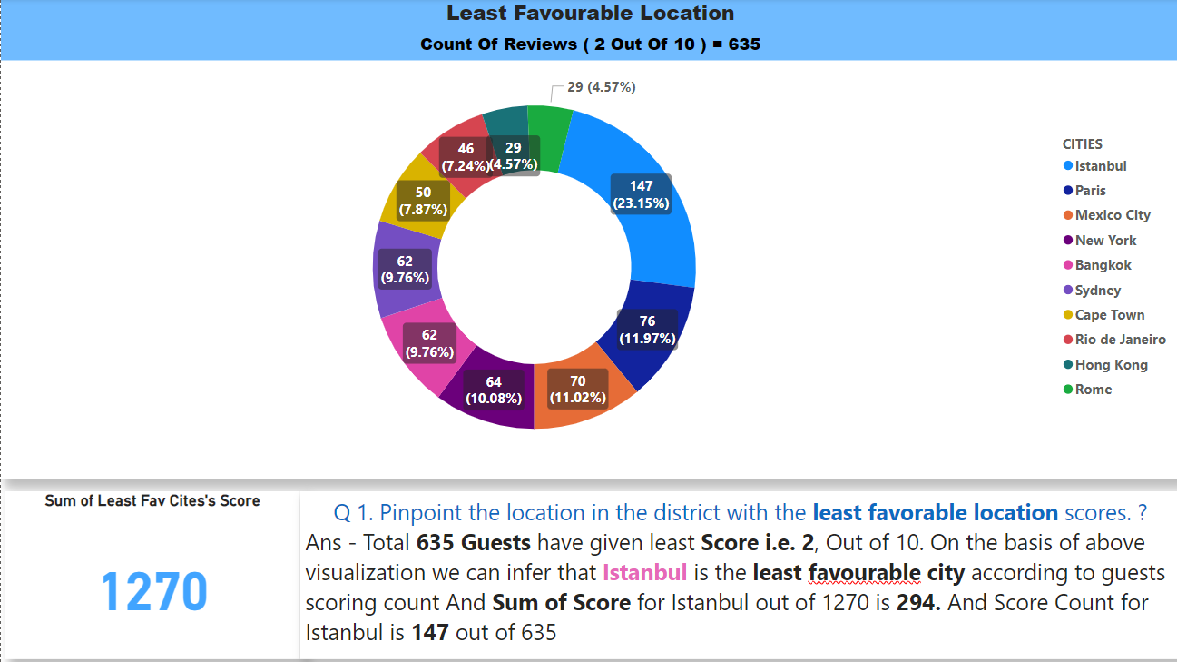
Findings / Evaluation
ISTANBUL
least favourable location :-

Slide 6
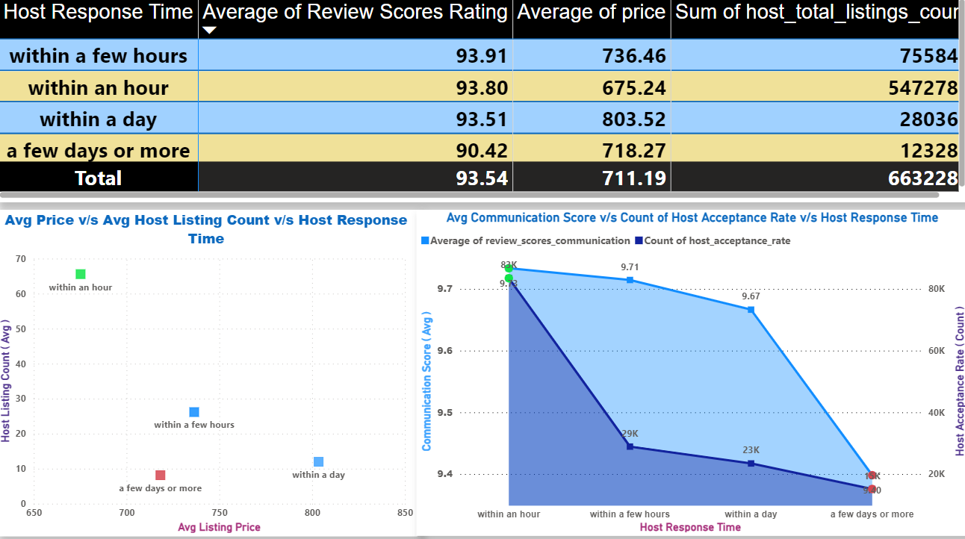
Findings / Evaluation
Guests Have Given Good Review Ratings To Those Hosts, Who Have Responded Within An Hour OR Few
2. Host Response Time Impact :-
Reason may have been, High Response time along with Lowest Avg Price and Max listed Properties
Even though, Hosts who respond after few days are offering 2nd lowest Avg price still got least Review Score
Reason Being, less property, do not Communicate much, least Acceptance Rate
Also, We can infer that Host Who Communicate more with the Guests, have more Acceptance rate then the others

Slide 7
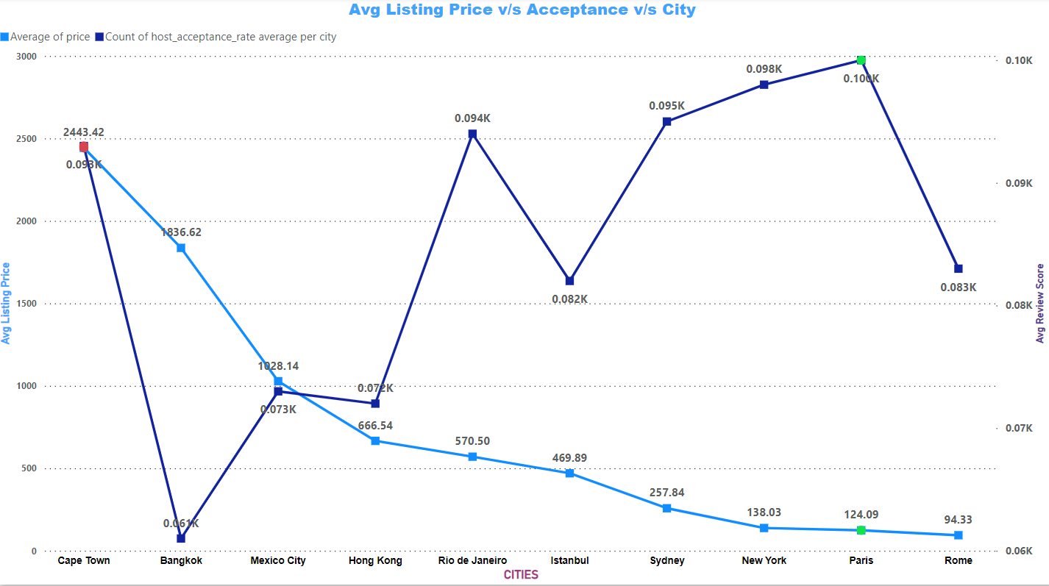
Findings / Evaluation
4 . Airbnb listing prices and noteworthy trends or variations
Paris, NY, Sydney have the High Acceptance rate at the given Avg Price, which shows that Guests are Preferring these cities more then the other cities
Bangkok Has High Avg listing price then the others and Very Low Acceptance Rate from Guests

Slide 8
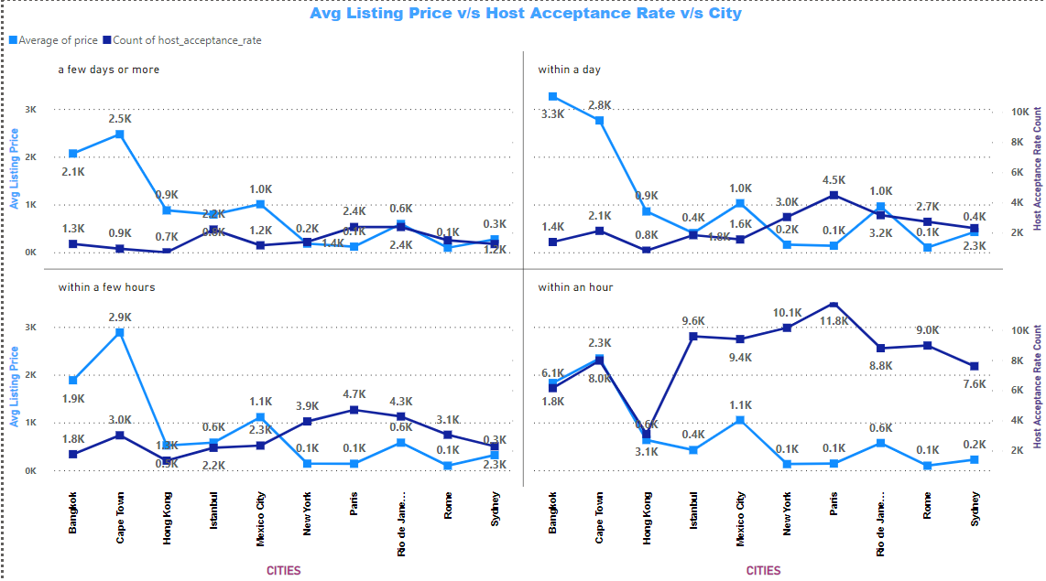
Response Category Wise Analysis
One of the reason for these cities to become favourable place is that Hosts are well versed to communicate with guests and Responding within time.
That is why getting high Acceptance from their guests.

Slide 9

Findings / Evaluation
5 Listing Age and Host Tenure
Total 26,000 Hosts Have Completed their 10+ yea’s of hosting

Slide 10
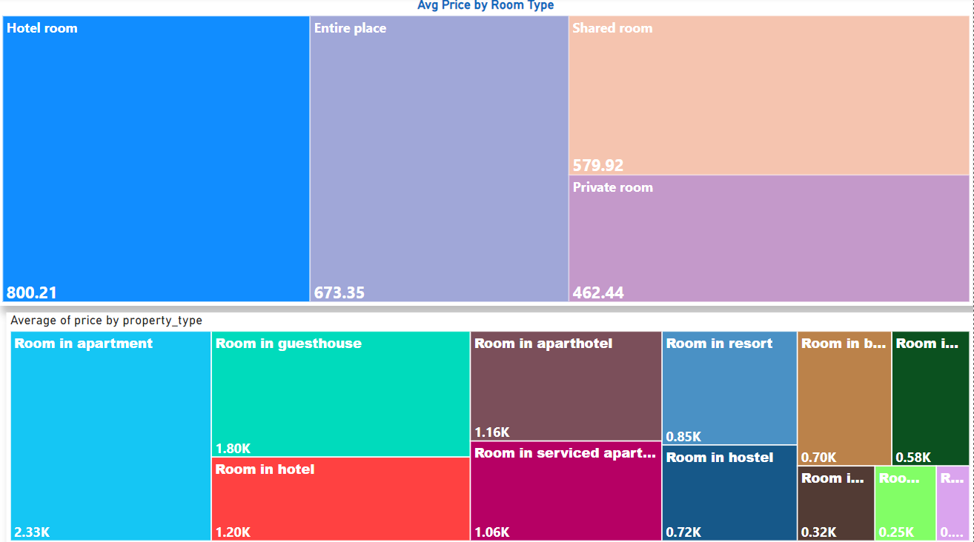
Findings / Evaluation
6 Property Type Price Analysis
Hotel Room type has the highest Avg price i.e 800 USD among all the available room types
In Hotel Room Category , Rooms in Apartment has the Maximum landing costst which is around 2033 USD

Slide 11
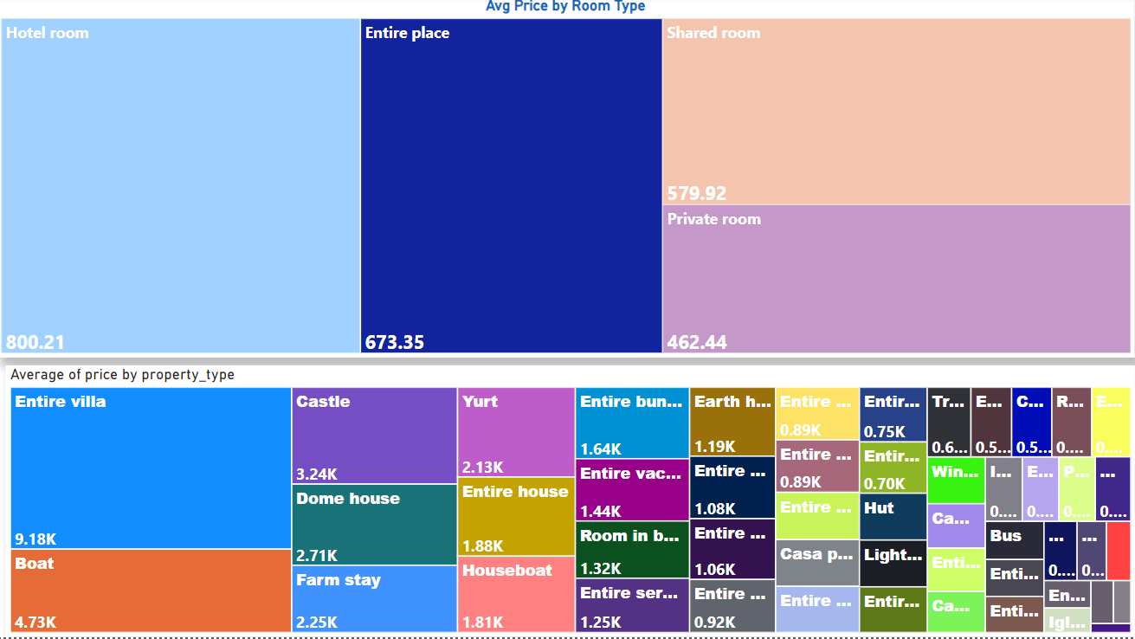
Findings / Evaluation
6 Property Type Price Analysis
Entire Place type has the highest Avg price i.e 674 USD among all the available room types
In Entire Place Category , Entire Villa has the Maximum landing costst which is around 9018 USD

Slide 12
Thank You

